Slide 1
Digging into Linked Data: Perspectives from the Long Tail
Paromita Biswas, Western Carolina University (WCU)
Andrea Leonard, Appalachian State University (ASU)
Texas Conference on Digital Libraries 2018

Slide 2
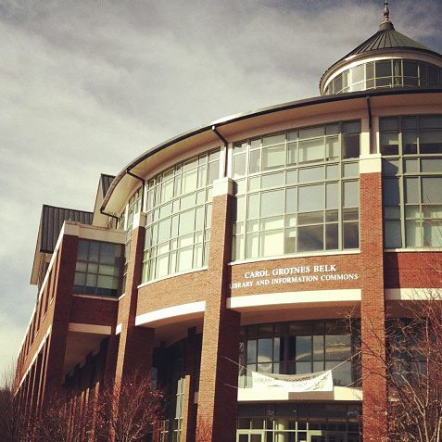
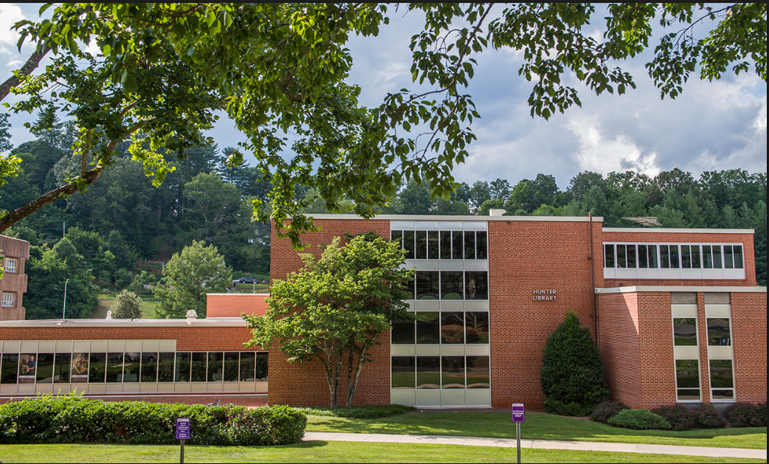
Belk Library & Information Commons, ASU
Hunter Library, WCU

Slide 3
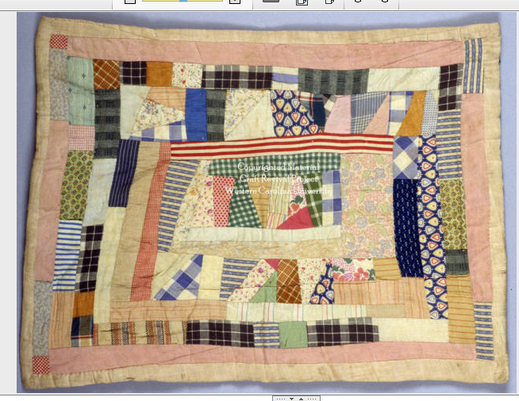
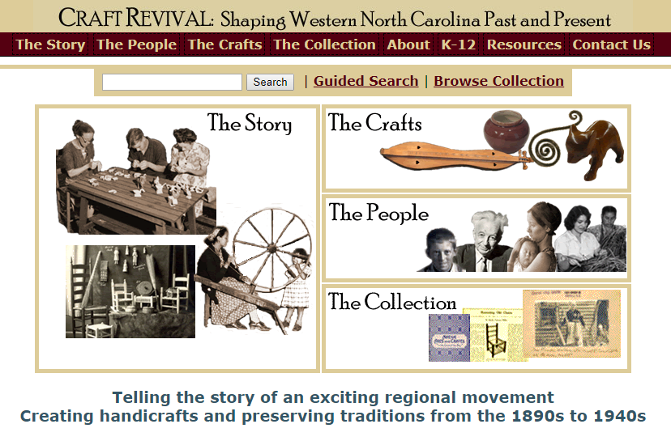
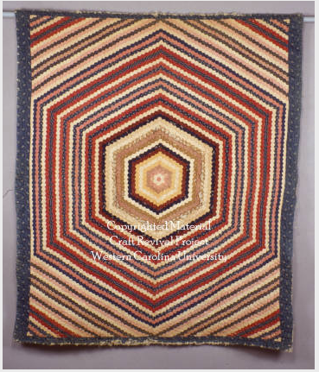
Choosing the dataset: WCU
No. of items
Oldest and most extensive collection
on Appalachian culture and heritage
Number of items for project: 25

Slide 4
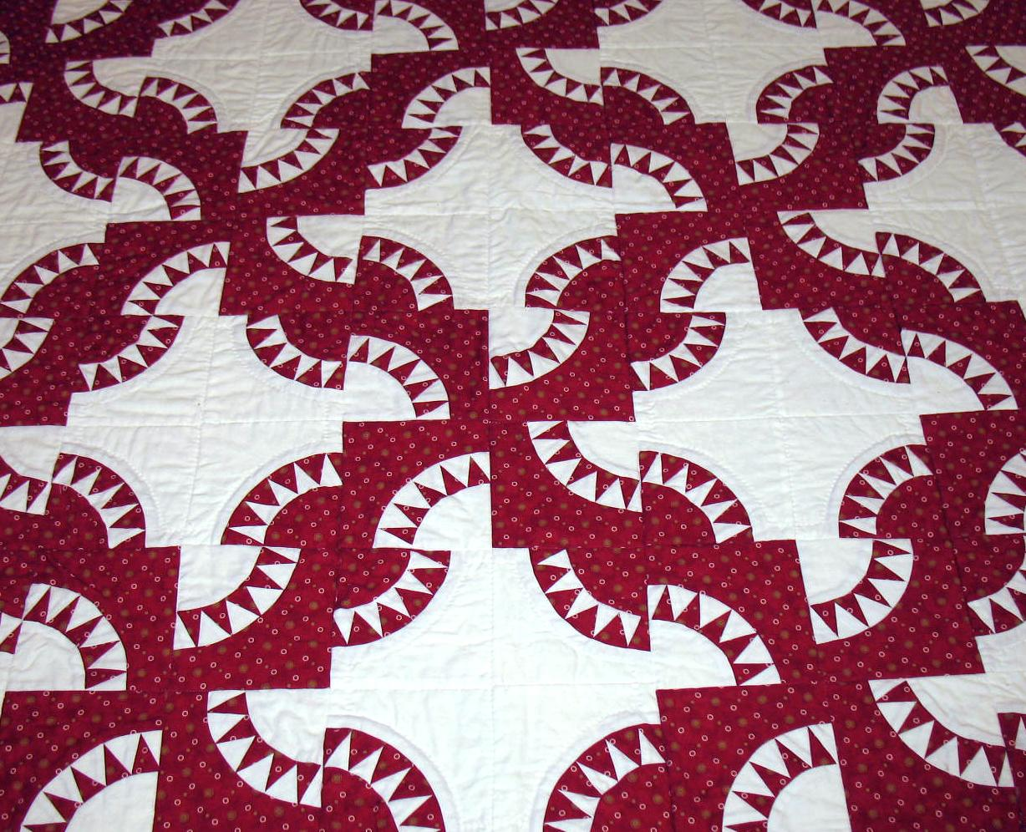
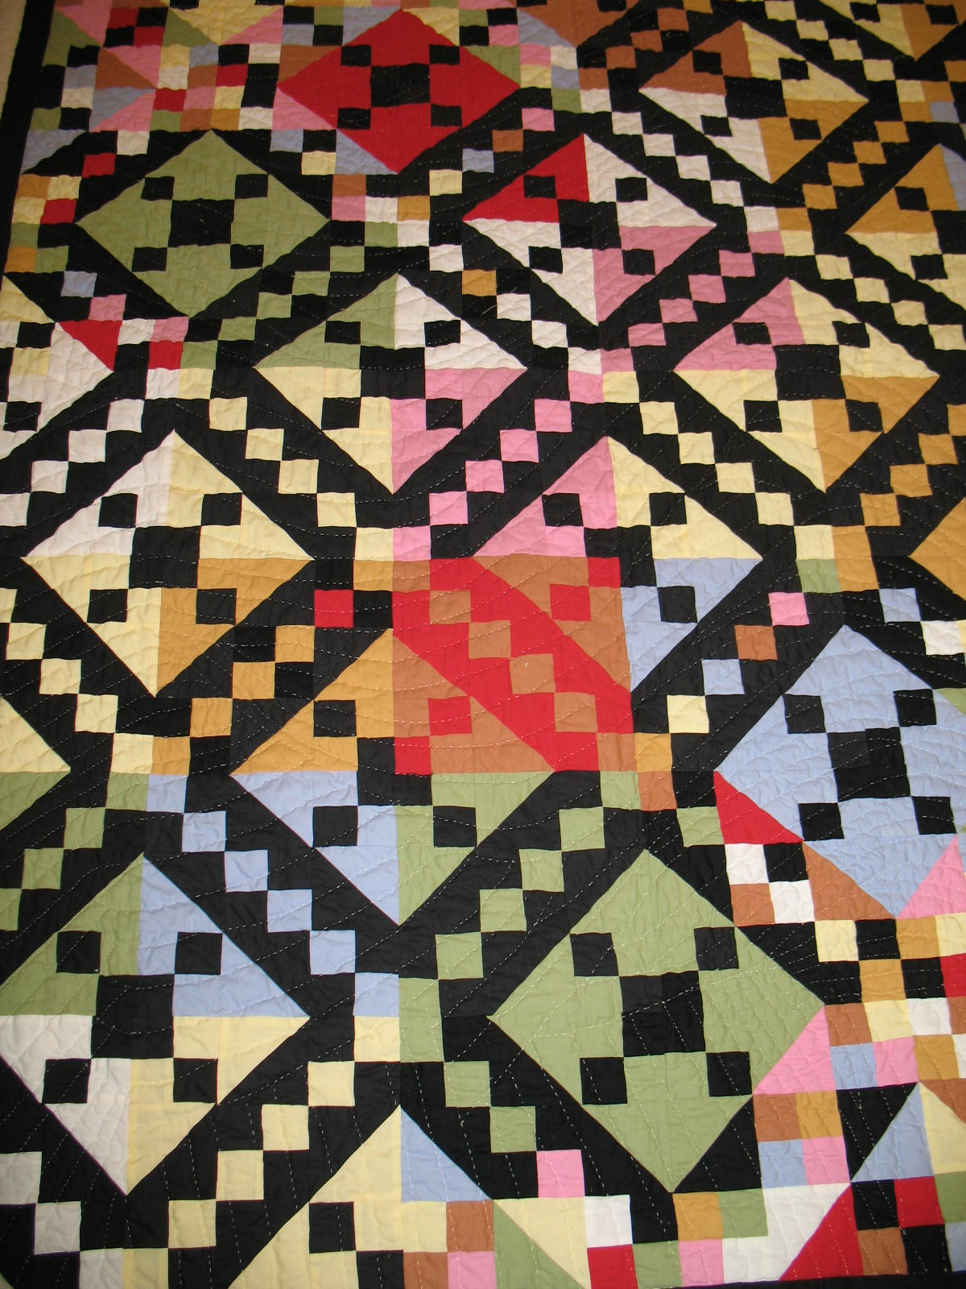
Choosing the dataset: ASU
Number of items for project: 20
Quilts found in:
  University Library Art Collection
  ASU Historical Photos
  Kirby and Eller Family Letters

Slide 5
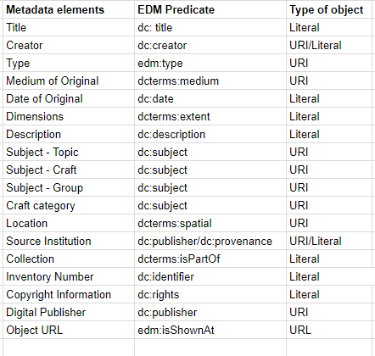
Learning Curve: Concepts
Mapping
Data Models/Mapping
Europeana Data Model: ProvidedCHO (core class) and its properties
(EDM provides the option to map to Dublin Core terms)
Resource Description Framework (RDF)
Data in triple statements
Literals and URIs
5 star data
Dereferenceable URIs/Reuse URIs
RDF Serialization: Turtle-Terse RDF Triple Language
Easily readable and could be manually written
See:
*Silvia B. Southwick, A Guide for Transforming Digital Collections Metadata
into Linked Data, Journal of Library Metadata (2015)
*Heath and Bizer, How to Publish Linked Data on the Web
*Sauermann et al. Cool URIs for the Semantic Web (2006)

Slide 6
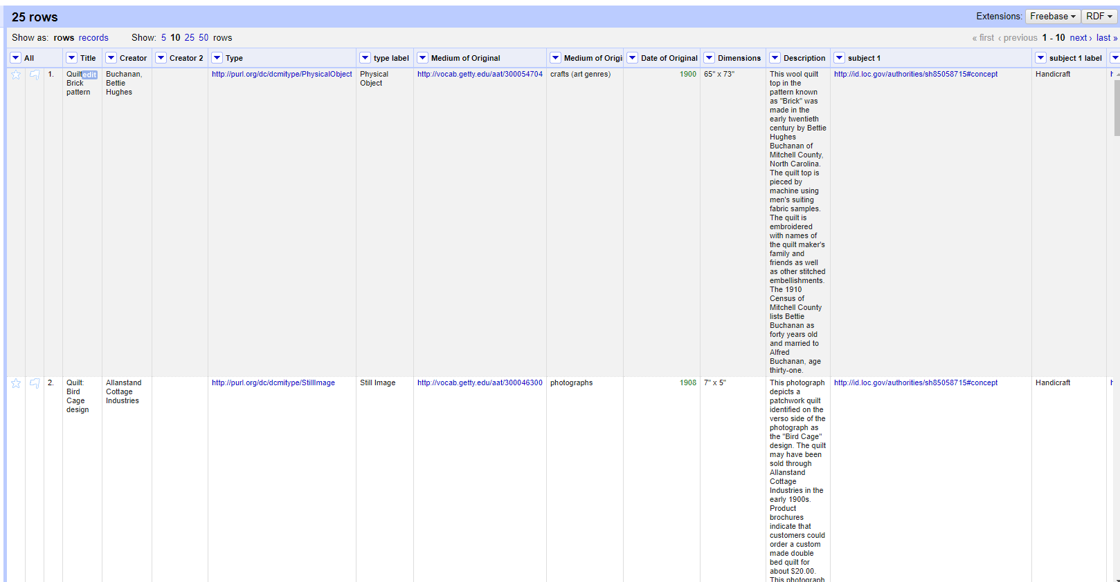
Learning Curve: Tools
Getting the data ready; uploading to OpenRefine
Adding the RDF extension and reconciliation services
Reconciling controlled vocabularies with established URIs
(LCNAF/LCSH/VIAF/Getty/DBPedia/Wikidata)
See:
*Verborgh and De Wilde’s Using OpenRefine (2013)
*Hooland and Verborgh, Linked Data for Libraries, Archives and
Museums (2014)
Edit RDF Skeleton (RDF Schema Alignment)
creating the URI for the ProvidedCHO:
<Namespace><class of thing described>/<local unique ID>
Inventory no./Omeka no.
Triple stores and SPARQL
Apache Jena Fuseki/practice querying
Apache Marmotta/visualization
Querying RDF/linked data with SPARQL
*Certificate in XML and RDF-Based Systems (Library Juice Academy)

Slide 7
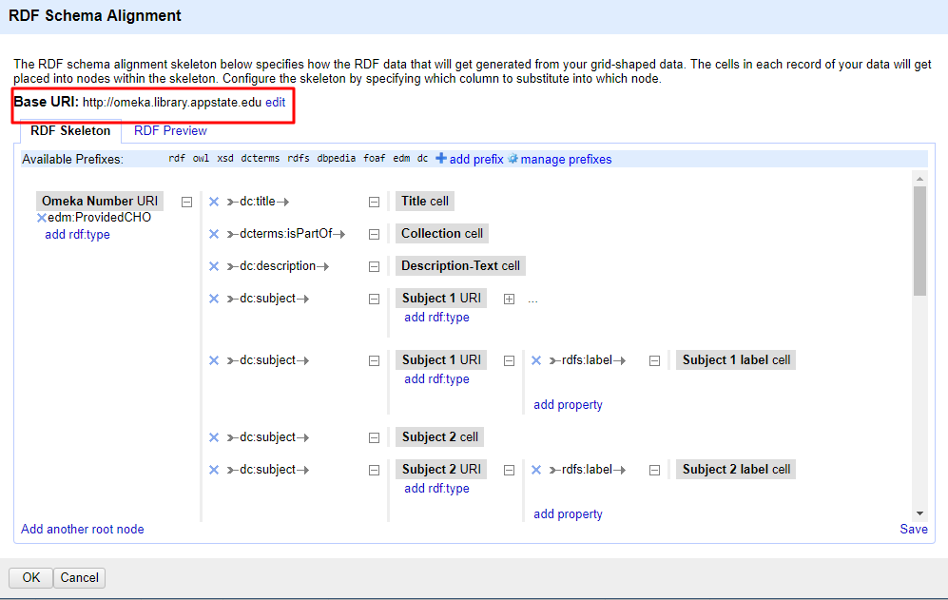
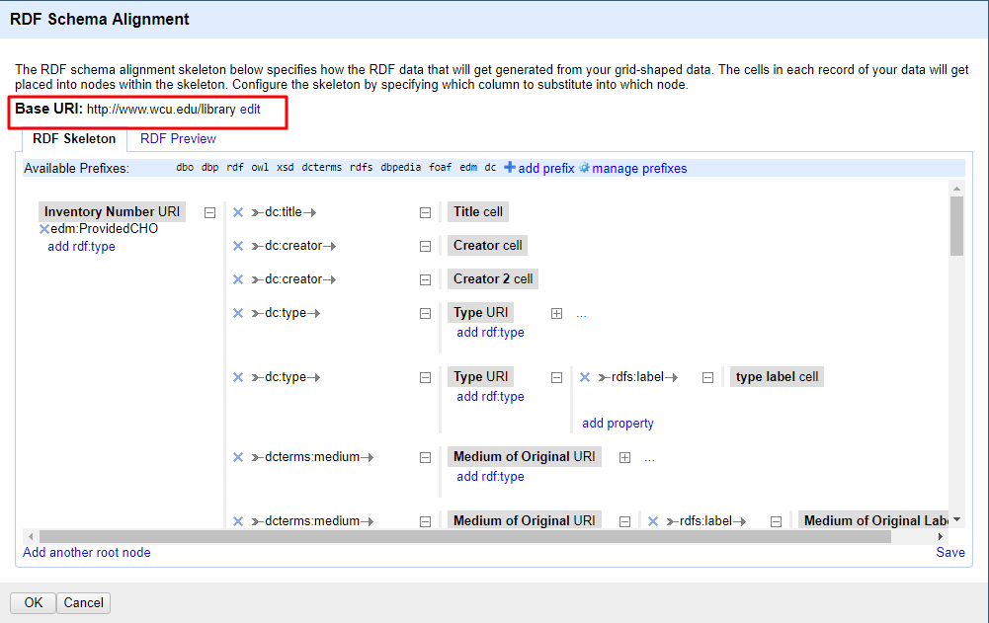
Tools--RDF Skeleton

Slide 8
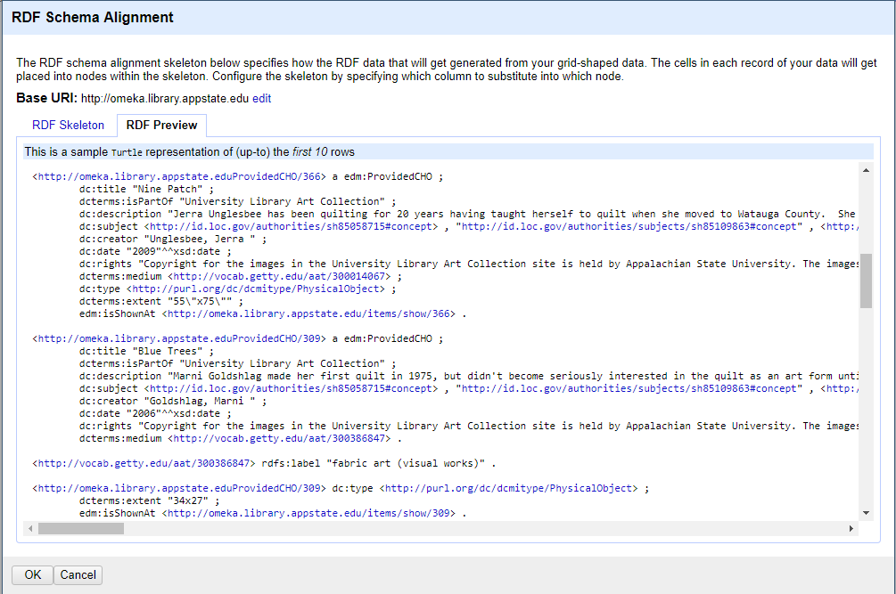
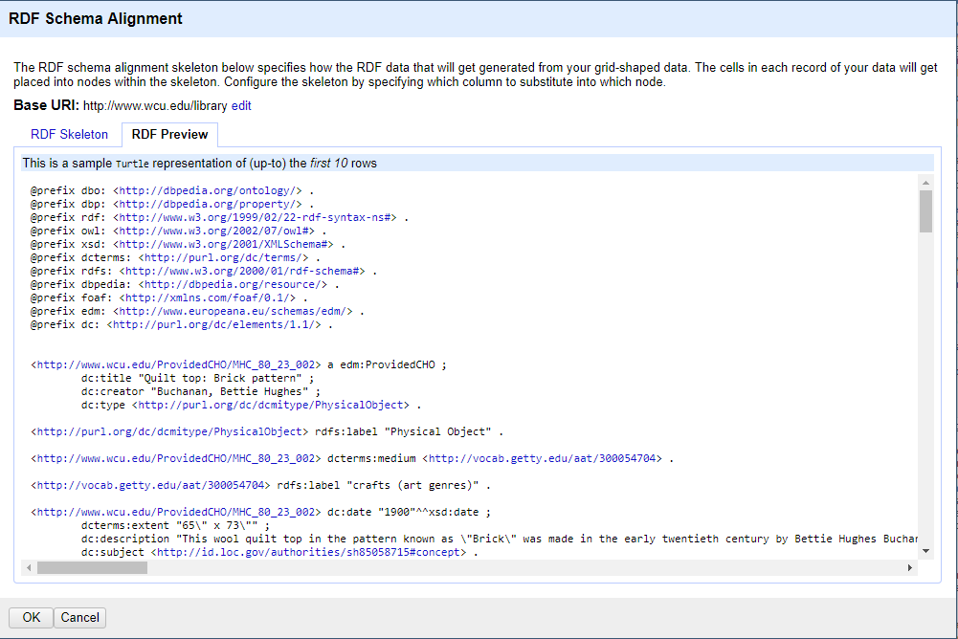
RDF Preview (Skeleton)

Slide 9
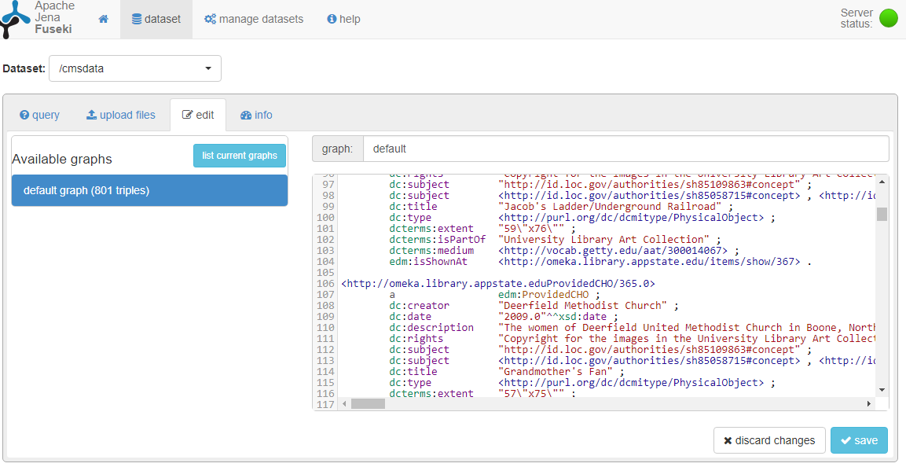
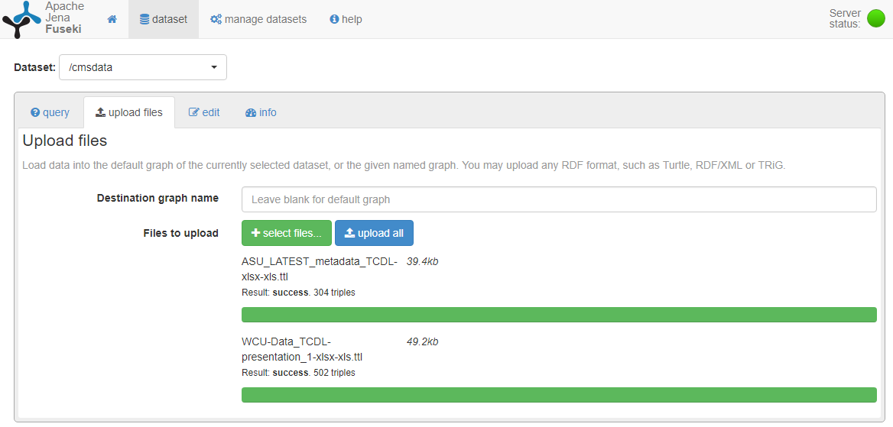
Fuseki

Slide 10
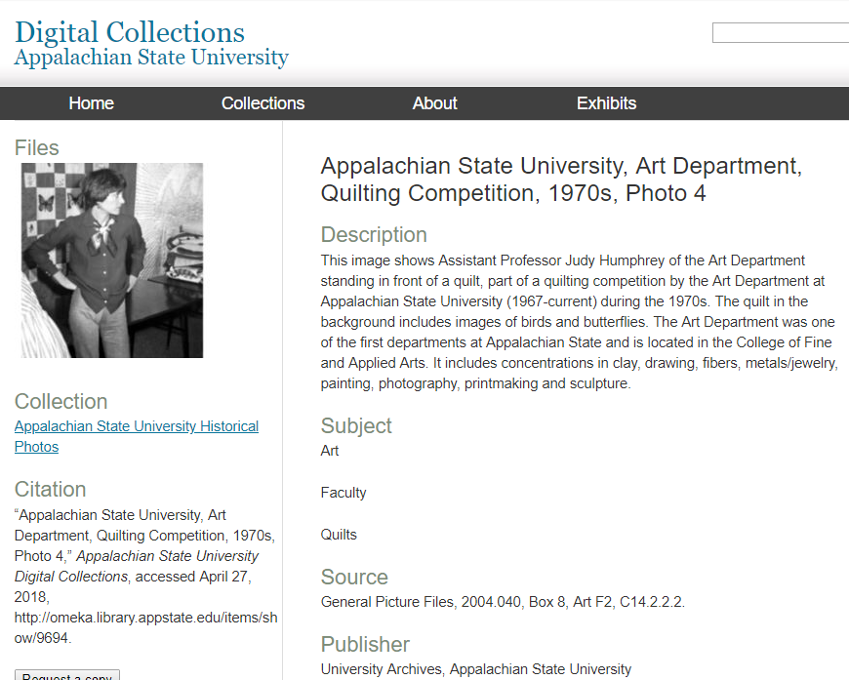
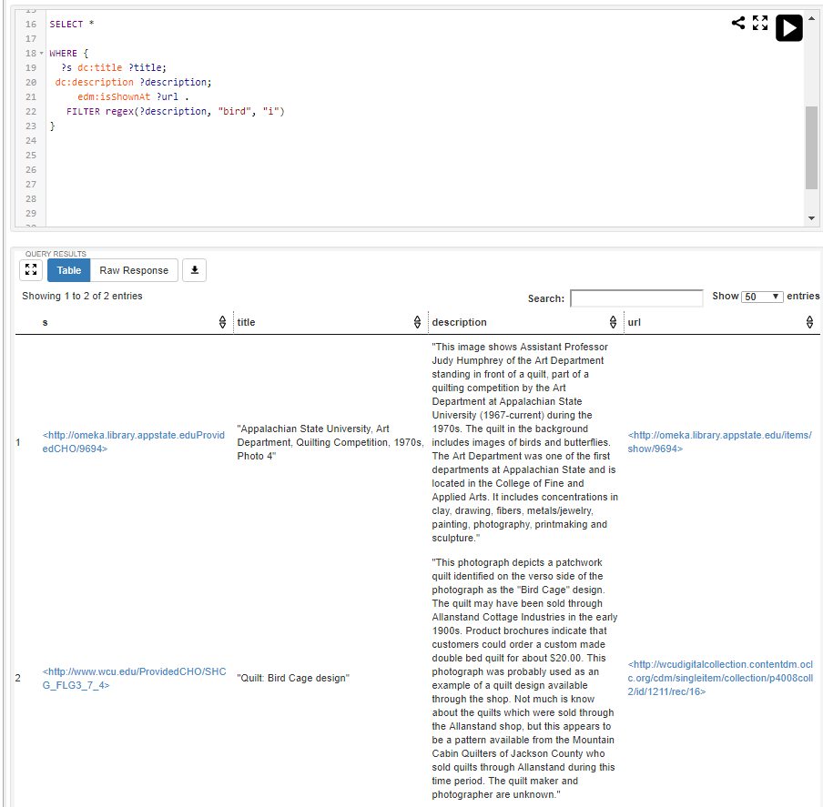
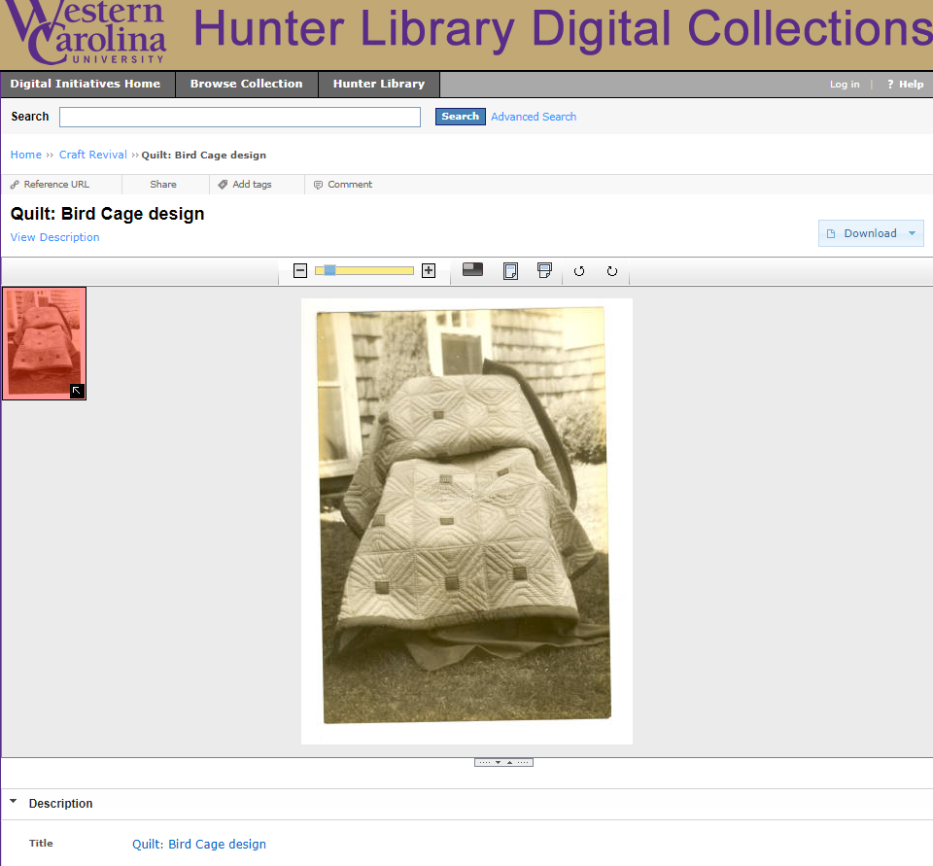
Querying the data

Slide 11
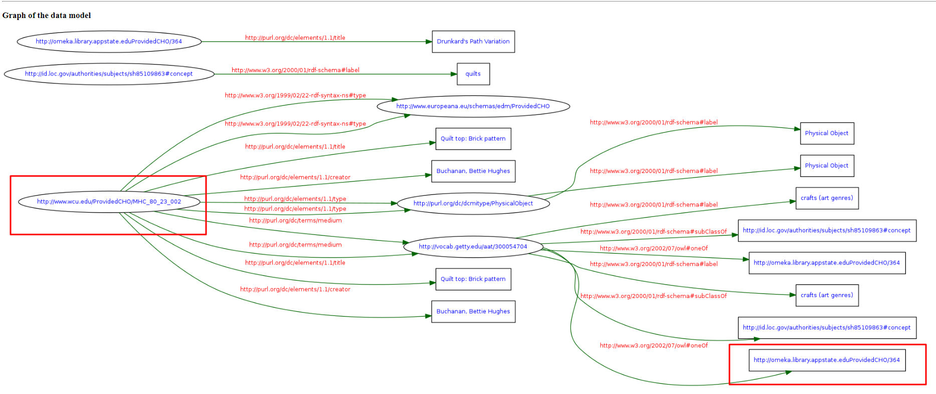
Graphs/Relationships
https://www.w3.org/RDF/Validator/

Slide 12
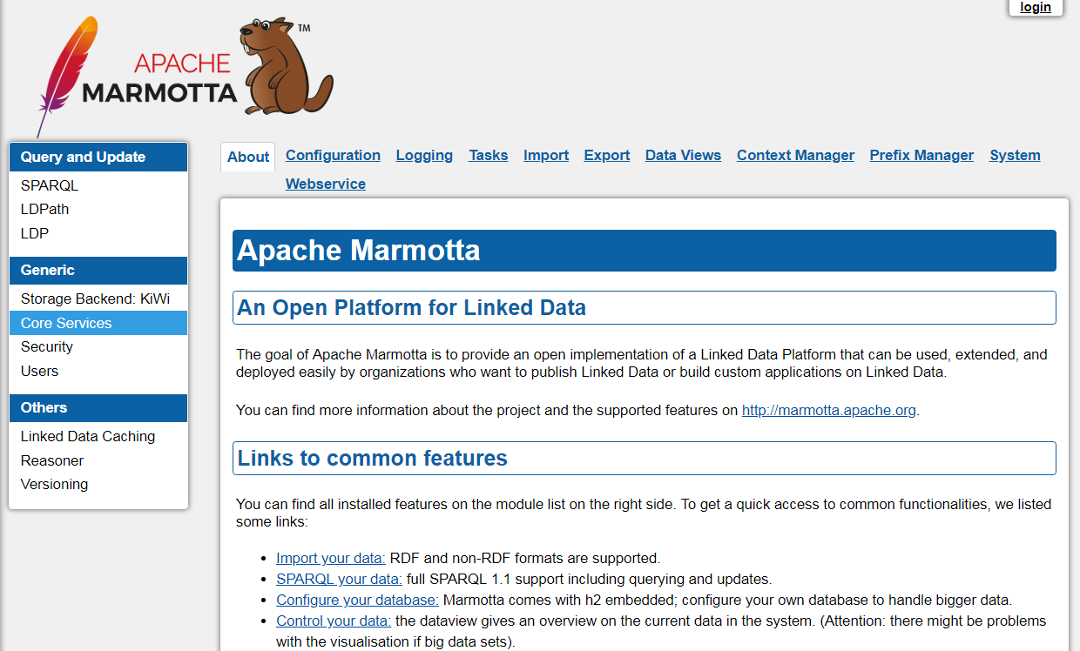
Current Project Status

Slide 13
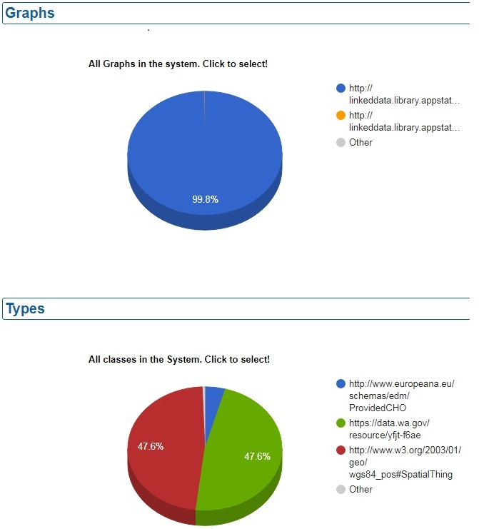
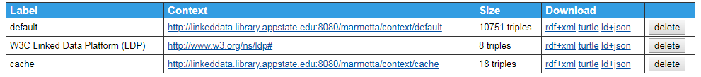
Data Views generated by
Apache Marmotta
Graphical representation of data:
Graph of the “graphs”
Types of classes
“Contexts” (“graphs” in SPARQL):
The triple containers with their own URI

Slide 14
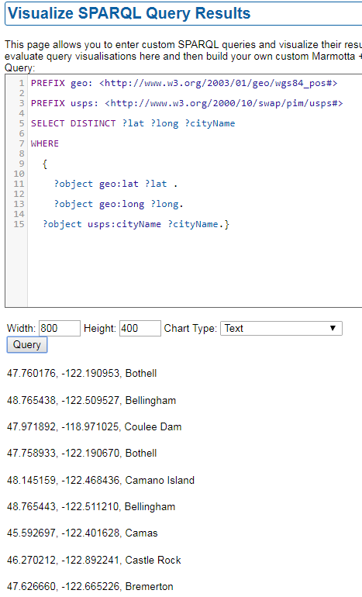


Slide 15
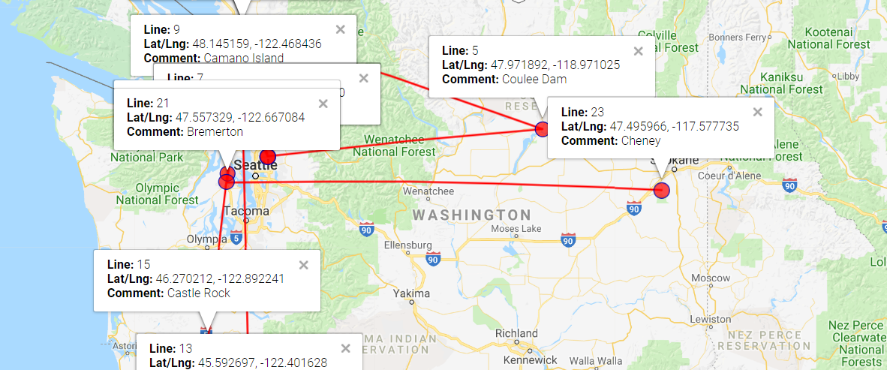
Hope versus reality:
Will we be able do with this with Apache Marmotta…?
Manual visualization via Darrin J. Ward’s Mapping Tool https://www.darrinward.com/lat-long/

Slide 16

Challenges Overall
Time gaps & work loads
Learning curves & training
Metadata cleanup
Moving landscapes
Institutional growth angst
Challenges with systems

Slide 17

Benefits
Theoretical to practical
Open source technologies
Collaboration and connections
Groundwork for future projects

Slide 18

Next Step(s)
PHASE TWO

Slide 19
Thank you!
Tom Bennett, Operations & Systems Analyst: Apache Marmotta setup
Scott Goldstein, Web Librarian: giving SPARQL queries for visualization a try

